Slide 1

Capstone Project

Slide 2
Marketing Analytics
Revenue Analysis and Customer Segmentation

Slide 3
Problem Statement
The Aesthetes Co. is an online gifting company. They serve their online customers by offering their products and services for different occasions. They do organic and paid marketing by creating creative ad campaigns.
The company wanted to increase their customer base and increase their Revenue on sustainable basis.
That’s why, the company wanted to design customer centric online ad campaigns to attract customers and increase their revenue

Slide 4
To know the total orders and revenue generated on monthly to see the patterns and trends.
To know the peak time of customers’ orders on weekly and hourly basis to analyze patterns of customers’ traffic.
Learn about Customer Segments using RFM model to optimize marketing strategies and design customer–centric marketing ad campaigns to increase the retention rate and generate more revenue
Objective
Statement

Slide 5
Data Analysis Process
Data Preparation and Cleaning
RFM Modeling
Exploratory Data Analysis
Results and Recommendation
Business understanding and define objectives

Slide 6
Data Overview
This is the Data of a retail transaction of a gifting company. The dataset has 8 attributes and 5,41,909 records.
Attributes | Data Type | Description
InvoiceNo | Nominal | 6-digit integral number uniquely assigned to each transaction. If this code starts with letter 'c', it indicates a cancellation.
StockCode | Nominal | 5-digit integral number uniquely assigned to each distinct product
Description | Nominal | Detailed description of the product with name
Quantity | Numeric | The quantities of each product (item) per transaction.
InvoiceDate | Datetime | The day and time when each transaction was generated
UnitPrice | Numeric | Numeric, Product price per unit in dollars.
CustomerID | Nominal | 5-digit integral number uniquely assigned to each customer
Country | Nominal | the name of the country where each customer resides
Data Source: https://archive.ics.uci.edu/ml/datasets/online+retail#

Slide 7
Data Analysis
And
Visualization
Revenue Analysis and Customer Segmentation

Slide 8
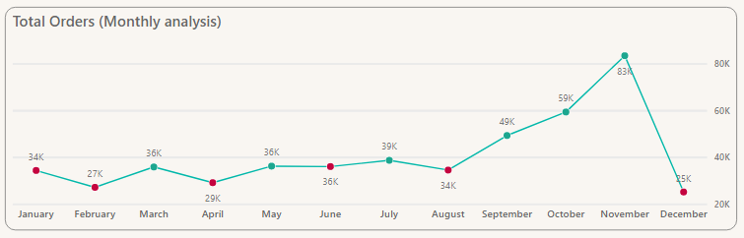
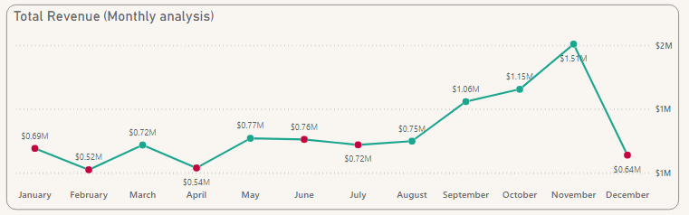
Monthly
Analysis
Based on the graph, November is the month with the highest sales and February is the month with the lowest sales.
The overall Revenue is 6.38% .
Notes:
This is the monthly analysis of total orders and revenue. There is fluctuation in orders receiving and revenue based on certain factors. Since, it’s a gifting company so seasonality could be one of the factors in this increase and decrease. Based on the graph, November is the month with the highest sales and February is the month with the lowest sales.
The overall Revenue is 6.38% .

Slide 9
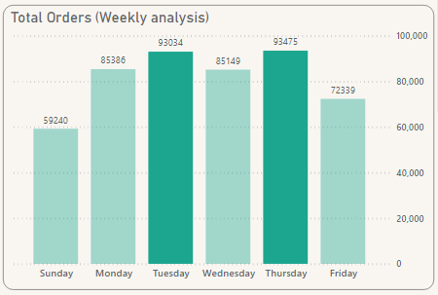
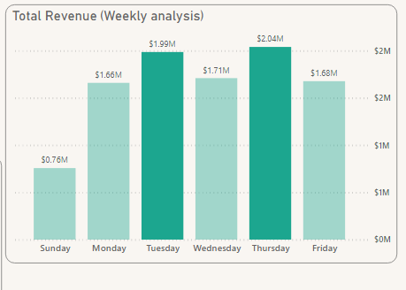
Weekly Analysis
Mostly orders have received in Thursday followed by Tuesday and revenue generation which means that Customers are mostly active in these two days.
This helps to see the incoming customer traffic for paid marketing strategies.

Slide 10
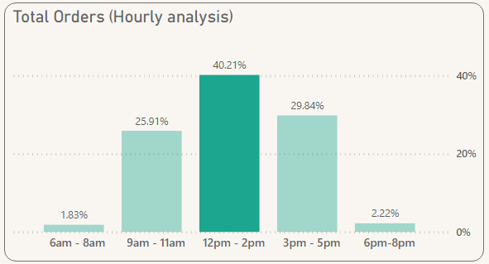
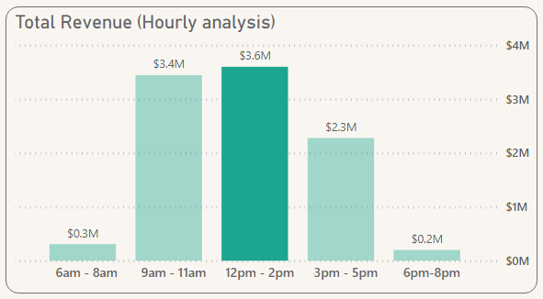
Hourly Analysis
40.21% orders have received from 12pm-2pm. This is the peak time of orders receiving.
This graph helps to analyze the most responsive time of customers.

Slide 11
Customer Segmentation
RFM Model

Slide 12
Customer Segmentation
Understanding consumer behavior is essential for a company.
Every customer has a different thought process and attitude towards buying a particular product, therefore customer segmentation is necessary.
Customer Segmentation
Importance
Understanding who your most valuable customers are and why
Retention of Consumers
Improve Customer Service
Customer Differentiation
Creating targeted campaigns and ads to resonate with and convert segments of customers
Identifying new opportunities for products, support, and service efficiently

Slide 13
RFM Model
RFM (Recency, Frequency & Monetary) analysis is a behaviour based technique used to segment customers by examining their transaction history
R-Recency
F- Frequency
M- Monetary
The freshness of customers activity.
E.g.: Time since last purchase
The frequency of customer transaction.
E.g.: The total number of recorded transactions
The willingness to spend
E.g.: The total transaction value.
Notes:
RFM (Recency, Frequency, Monetary) analysis is a proven Marketing model for behavior-based Customer segmentation. It groups customers based on their transaction history – how recently, how often and how much did they buy. In a simple way it can be considered a model based on the Pareto principle – commonly referred to as the 80-20 rule.

Slide 14
Marketing Rule
Pareto
Principle
80/20 Rule
In the same way, 20% customers contribute to 80% of your total revenue.
Explanation
80% of the output from is determined by 20% of the input
People who spent once are more likely to spend again. People who make big purchases are more likely to repeat them.
Pareto Principle is the core of RFM Model. Focusing your efforts on critical segments of customer is likely to give you much higher return of investment.
Notes:
There is a Pareto principle that majority of work is done by a small amount of input and vice versa. With the same rule applied in marketing, a majority chunk of revenue is generated by a small number of customers. RFM Model is based on this rule and we segment our customers to see the most revenue generating customers and least revenue generating customers so we can design our marketing strategies to convert our customers into top customers.

Slide 15
01
Data Assembly/ Importing
RFM
Analysis
Process
Calculate RFM Values/
Metrices
02
03
Score Designation to RFM Values and merge RFM Scores as RFM Segment
Segment Classification
04
Notes:
Calculating RFM Assign a number from 1 to 5 for each category, where 5 is the highest and 01 is the lowest. In order to calculate RFM, we´ll need some data on customers:
Their most recent purchase date.
Number of purchases within a set time period (i.e. one year).
Total sales from that customer
Recency
when was the last time the customer made a purchase? Customers who purchased from you recently are more likely to buy from you again than customers from the distant past. This is the important ranking factor–that’s why it’s first in the list.
2. Frequency How often does the customer buy? A customer who is in every day is much more likely to buy again that someone who only comes in once a year. How many invoices are registered by the same customer?
3. Monetary
How much did your customer spend? A customer who makes a large purchase is more likely to buy again than a customer who spends less.

Slide 16
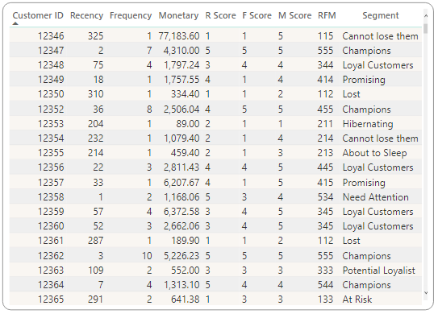
RFM Table
Customer with ID 12346 has:
Recency: 325 days
Frequency: 1 time
Monetary: $ 77,183.60
RFM Segment: 115
Segment: Cannot Lose them

Slide 17
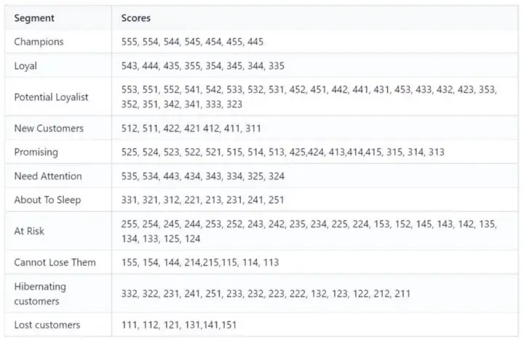
RFM
Scoring
Table

Slide 18
Customer Segments Characteristics
No. | Customer Segment | Characteristics | Actionable Tip
1 | Champions | Bought recently, buy often and spend the most! | Reward them. Can be early adopters for new products. Will promote your brand.
2 | Loyal Customers | Spend good money with us often. Responsive to promotions. | Upsell higher value products. Ask for reviews. Engage them.
3 | Potential Loyalist | Recent customers, but spent a good amount and bought more than once. | Offer membership / loyalty program, recommend other products.
4 | Recent Customers | Bought most recently, but not often. | Provide on-boarding support, give them early success, start building relationship.
5 | Promising | Recent shoppers, but haven’t spent much. | Create brand awareness, offer free trials
6 | Customers Needing Attention | Above average recency, frequency and monetary values. May not have bought very recently though. | Make limited time offers, Recommend based on past purchases. Reactivate them.
7 | About To Sleep | Below average recency, frequency and monetary values. Will lose them if not reactivated. | Share valuable resources, recommend popular products / renewals at discount, reconnect with them.
8 | At Risk | Spent big money and purchased often. But long time ago. Need to bring them back! | Send personalized emails to reconnect, offer renewals, provide helpful resources.
9 | Can’t Lose Them | Made biggest purchases, and often. But haven’t returned for a long time. | Win them back via renewals or newer products, don’t lose them to competition, talk to them.
10 | Hibernating | Last purchase was long back, low spenders and low number of orders. | Offer other relevant products and special discounts. Recreate brand value.
11 | Lost | Lowest recency, frequency and monetary scores. | Revive interest with reach out campaign, ignore otherwise.
Notes:
file:///C:/Users/Malik/Desktop/Online%20Retail%20Capstone%20Project/1_YWJYf6hl1jo0RqjHkkw7Xw.webp

Slide 19
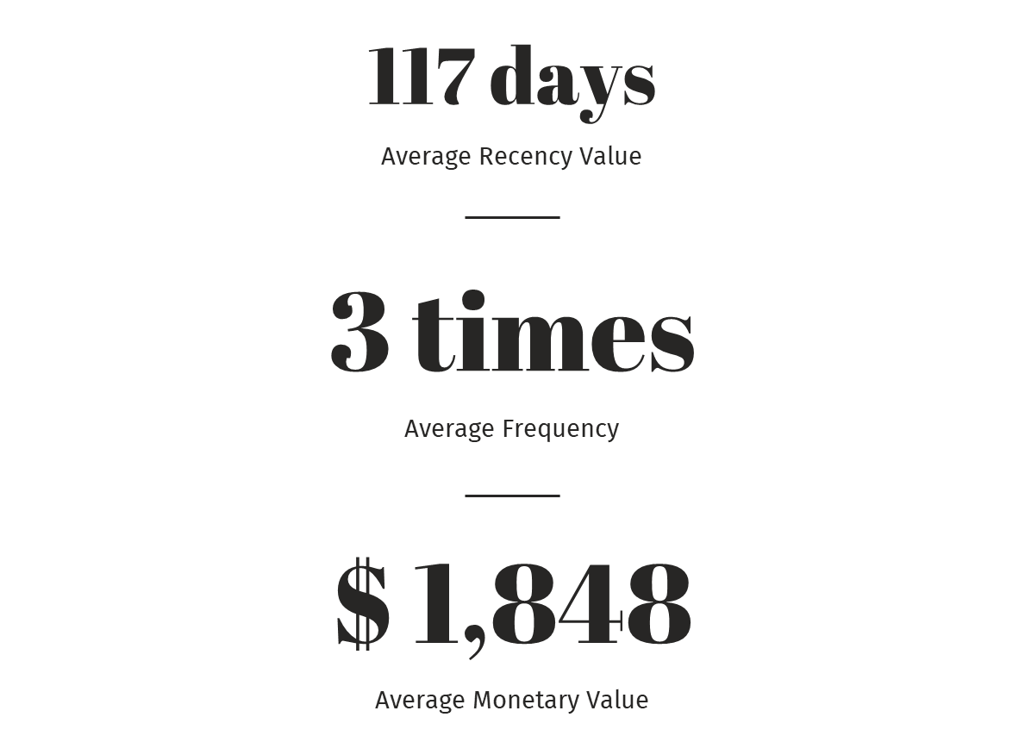
117 days
Average Recency Value
Average RFM
Values of
Customers
3 times
Average Frequency
$ 1,848
Average Monetary Value
Notes:
These are the average of our RFM Model. The average recency of our customer is 117 days which is almost 04 months. Average customer visits our website 3 times to order and average worth of order is $1,848.

Slide 20
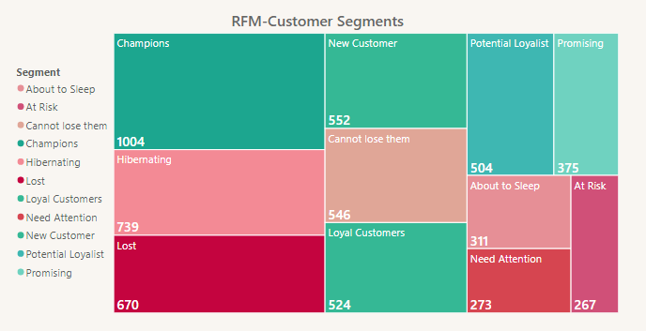
Customer Segmentation Analysis
Notes:
This is the tree map of our customer segmentation distribution. Majority of our customers are Champions who are also top customers followed by hibernating who are at the edge of churning (leaving the organization) and our lost customer is 670 which means that our churn rate is 12%.

Slide 21
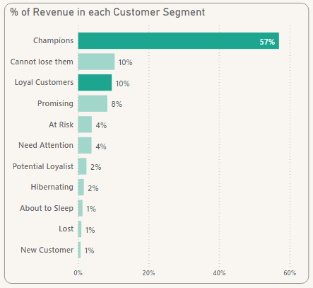
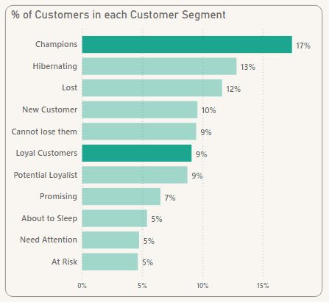
RFM Customer Segments
Champions and Loyal Customers
26% are Champions and Loyal Customer and more than 50% revenue is generated from Champions customers followed by “Can’t lose them” customers.

Slide 22
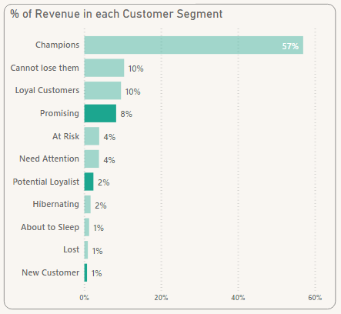
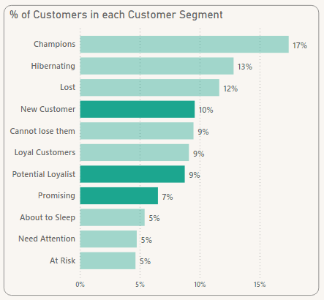
RFM Customer Segments
Potential, New and Promising Customer
25% customers are Potential Loyalist, New Customers, and Promising customers and generating 10% revenue. They can be converted to Loyal customers.

Slide 23
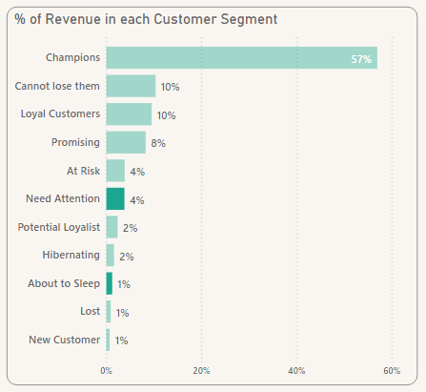
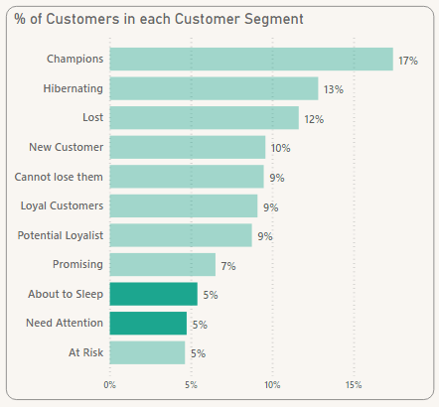
RFM Customer Segments
About to Sleep and Need Attention
10% customers need attention and about to sleep as they are in above and below averages and only generating 5% revenue.

Slide 24
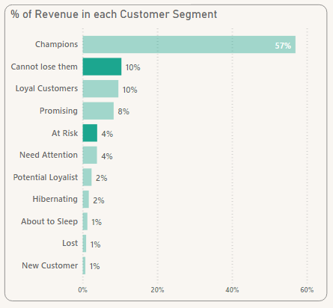
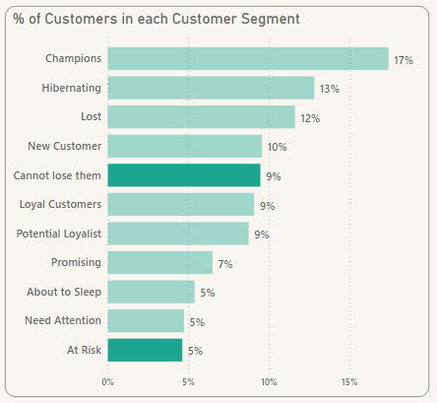
RFM Customer Segments
Customers at Risk and Can’t be Lose
14% are At Risk and Can’t lose them category and generating 14% Revenue.

Slide 25
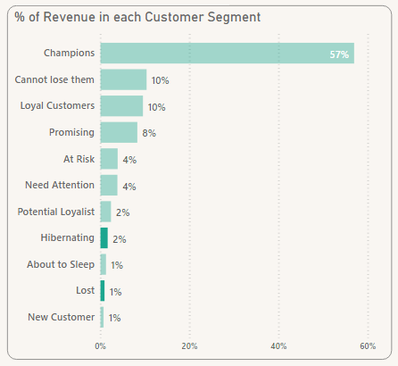
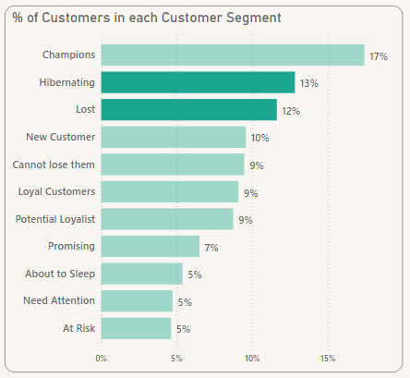
RFM Customer Segments
Hibernating and Lost Customers
13% are hibernating and Churn Rate is 12% which means that company has lost 12% customers who used to generate less than 1% revenue.

Slide 26
Distribution of Customers
24.82%
26.51%
Potential Loyalist, New and Promising Customers
Champions and Loyal
5,675
10.13%
Need Attention & About to Sleep
Total Customers
14.10%
24.44%
At Risk & Cannot Lose Customers
Hibernating and Lost Customers
Notes:
This is the summary distribution of our customer segmentation analysis.

Slide 27
Recommendations:
Announce incentive offers in low order receiving months. Peak time online advertisements
Top Customers: Reward programs and send personalized product updates. They are early adopters and helps in promoting our brand
Potential to become top customers and new customers: Build healthy relationships by offering free trials, free shipping and complementary services
For customers who are at risk and cannot lose them category: Reconnecting, offer renewals, ask for their feedback. We can not lose them to competition
Need attention and About to sleep: Offer renewals and win back campaigns, give recommendations based on past purchases. Ask for feedback
Hibernating and churn: Recreate brand value and offer relevant product suggestions or asking for feedback to make relevant improvisations in our process
Notes:
Recommendations:
Company should announce incentive offers in low order receiving months (Dec, Jan and April) to increase their revenue. Company should post their online ads by keeping the peak customer traffic time and days in mind to achieve optimum results.
Top Customers need to be pampered to stay loyal and willing to spend a lot of money to shop, for example by encouraging them to spread the love with reward programs and send personalized product updates. They are early adopters and helps in promoting our brand.
For customers having potential to become top customers and for recent customers, we need to build a healthy relationship to retain them over a long period of time by offering free trials, free shipping and complementary services.
For customers who are at risk and cannot lose them category, they are good spenders and we cannot lose them. It is very important to retain them by reconnecting, offer renewals, ask for their feedback. We can not lost them to competition.
It is important to reconnect with the customers who need attention and are about to sleep by offering renewals and win back campaigns, give recommendations based on past purchases. We can ask for feedback to get insights about their pain points.
For customers who are almost lost and churn, we can recreate brand value and offer relevant product suggestions or asking for feedback to make relevant improvisations in our process.

Slide 28

Thank
You!
mhadiqa7998@gmail.com
/hadiqamalik
/hadiqamalik

